Slide 1
Laws in IT
Week 1

Slide 2
Moore’s Law
The complexity for minimum component costs has increased at a rate of roughly a factor of two per year... Certainly over the short term this rate can be expected to continue, if not to increase. Over the longer term, the rate of increase is a bit more uncertain, although there is no reason to believe it will not remain nearly constant for at least 10 years. That means by 1975, the number of components per integrated circuit for minimum cost will be 65,000. I believe that such a large circuit can be built on a single wafer.

Slide 3
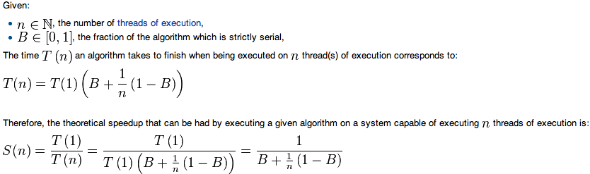
Amdahl’s Law
The speedup of a program using multiple processors in parallel computing is limited by the time needed for the sequential fraction of the program.

Slide 4
Amdahl’s Law

Slide 5
Bell’s Law
Roughly every decade a new, lower priced computer class forms based on a new programming platform, network, and interface resulting in new usage and the establishment of a new industry.

Slide 6
Gilder’s/Metcalfe’s Law
The value of a telecommunications network is proportional to the square of the number of connected users of the system (N²)

Slide 7
Hofstadter’s Law
It always takes longer than you expect, even when you take into account Hofstadter's Law.

Slide 8
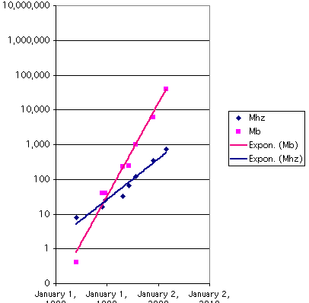
Kryder’s Law
Magnetic disk areal storage density is increasing very quickly, at a pace much faster than the doubling in semiconductor chip performance

Slide 9
May’s Law
Software efficiency halves every 18 months, compensating Moore's Law

Slide 10
Nielsen’s Law
Network connection speeds for high-end home users would increase 50% per year, or double every 21 months

Slide 11
Rock’s Law
Cost of semiconductor chip fabrication plant doubles every four years

Slide 12
Oriekhov’s Law ☺
In countries with low GDP per capita local IT expenditures are small percentage of GDP, in countries with high GDP per capita IT expenditures are high percentage of GDP. With GDP growth IT expenditures grow tree times faster and vice versa: when declining, decline at a three-fold speed.

Slide 13
Other laws
http://en.wikipedia.org/wiki/List_of_eponymous_laws

Slide 14
List of recommended software
Office Suite (Microsoft Office 2010 or 2013, IBM Lotus Symphony, Open Office, Libre Office)
Weka
SAP Lumira (for Windows OS only)
VMWare Player/VMWare Fusion
VMs from bitnami.com

Slide 15
List of recommended software
yEd
argoUML (other free UML editor)
Aris Community Edition

